Slide 1
Robert W. Alexander, MD, FICS * Summit ARTS 2026
“From Anecdote to Evidence”
Why Measuring What We Deploy Changes Everything !!
Vocabulary, standards, and the clinical imperative of establishing
dose–response relationships in tissue stromal vascular fraction (tSVF)
and high-density platelet-rich plasma (HD-PRP) therapies
Regenerative Medicine | Point-of-Care Standardization

Slide 2
EXECUTIVE SUMMARY
The Core Argument:
Clinicians routinely deploy tSVF + HD-PRP with therapeutic intent — yet in the majority of cases, neither the dose administered nor the biological quality of that dose is recognized nor documented !!
Without quantified doses, a documented outcome is merely anecdotal.
Point-of-care cytometry ability paired with a purpose-built centrifuge platform can close this gap — transforming everyday Biocellular/Orthobiologic procedures into reproducible, content-tracked clinical encounters.
Regenerative Medicine | Point-of-Care Standardization
2

Slide 3
Key Themes
I.
The Vocabulary Problem
Imprecise terminology undermines peer communication and patient consent
II.
Standards Much Needed
“WHAT” should be measured in uses of tSVF + HD-PRP, and the “WHY” Values
III.
“New” Small Heated Centrifuge Platform
As output device to help with content measure
IV.
Content–Response Values
Goal & The foundational scientific requirement for any therapy
V.
Practical Framework
Transitioning from “Anecdote to Documented
Evidence”
VI.
Field Implications
Aggregate clinical data as a complementary evidence base for OUTCOME ANALYSIS
Regenerative Medicine | Point-of-Care Standardization
3

Slide 4
I. THE VOCABULARY PROBLEM
Regenerative Medicine suffers terminology deficits that undermines peer communication and patient consenting
Many Terms: "stem cells," "SVF," "PRP,“ "stromal cells,“, “micronized”, “NanoFat”, SNIF, etc. are often used interchangeably and imprecisely.
FOUNDATIONAL PRINCIPLE:
A treatment cannot be said to have worked
if the treatment itself was never defined.
Regenerative Medicine | Point-of-Care Standardization
4

Slide 5
Precise Definitions vs. Common Misuse
TERM | PRECISE DEFINITION | COMMON MISUSE
tSVF (raw) | Heterogeneous cell-matrix from microcannula ATC; includes stromal, endothelial, immune, and progenitor cells | Can be Confused with pure MSC preparations; used synonymously with tSVF
tSVF | Living, tSVF with ability to show viability, total cell count, and size distribution testing tSVF) | Often assumed without measurements; "SVF" used when viability is unknown
HD-PRP | Platelet-rich plasma documented concentration ≥4× whole-blood baseline, confirmed by basic hemocytometry (baseline/concentration) | Often MARKETING TERM applied without measurement; concentration rarely specified
CONTENT | Total viable nucleated cells (or platelets) delivered by U/S to target tissue, with size and viability characterized (by testing of cSVF sample) | "A syringe of SVF" — OR- some volume without knowing actual biological content
Viability | % cells with intact membranes, shown by flow cytometry or fluorescent labeling at time of deployment, Cell counters may work + manual. | Assumed adequate; rarely tested in office settings; Flow Cytometry, FL Cell Counting
Response | A quantified, pre-specified outcome measure recorded at a defined time interval Post-Tx | Patient report of feeling better; VAS scores without baseline; No DOCUMENTATION
5

Slide 6
II. STANDARDS — tSVF Quantitively Measured
The clinically actionable minimum for tSVF & HD-PRP is: a
Relatively Simple Parameters:
1. Measure Numbers, Viability, Size in SAME-DAY clinical procedures
2. Measure the BASELINE Platelets In Simple Hemocytometer
3. Measure The Concentration of Platelets Achieved
4. RECORD In Every Patient’s Chart & Examine Outcomes
Regenerative Medicine | Point-of-Care Standardization
6

Slide 7
Clinically Actionable Minimums for tSVF
#1
#2
#3
VIABILITY tSVF
TOTAL COUNT
AVE SIZE PROFILE
% viable nucleated cells at time of injection
Absolute nucleated cell number per mL of final preparation
Average Mean diameter and distribution (µm)
Target: ≥ 90% In Fresh tSVF
Target: Total cells delivered
Target: Helps Identifies cell types
Method: FL Counters; BASIC Flow Cytometers
Method: Flow cytometer count × dilution factors; Cell Counters
Method: Relative For Cell Count
Why it matters?:
Why it matters?:
Why it matters?:
Ensures only living, functional cells are counted toward known Therapeutic Content
The quantitative content -- Essential for any response from content relationship
Stem/Stromal cells: 4–15 µm. HETEROGENEOUS Population - without defined therapeutic value
Regenerative Medicine | Point-of-Care Standardization
7

Slide 8
II. STANDARDS — HD-PRP DETERMINATION
The Baseline Requirement Determined: Standard CBC
HD-Platelet concentration can be expressed relative to
the individual patient's whole-blood baseline
NEW Inexpensive Hemocytometer Available – “RegeniSTAT”
HD-PRP Threshold:
≥ 4× baseline platelet concentration, confirmed by hemocytometry.
Regenerative Medicine | Point-of-Care Standardization
8

Slide 9
Why Baseline Matters: A Clinical Example
Post-spin preparation:
900,000 platelets / µL - Total
PATIENT A
PATIENT B
150,000 / µL Baseline
300,000 / µL Baseline
6× concentration
vs.
3× concentration
= HD-PRP ✓
= NOT HD-PRP
CLINICAL IMPLICATION
Same centrifuge. Same protocol. Same day. — 2× difference in platelet dose
Without baseline measurement, this Variability is NOT Visible.
Regenerative Medicine | Point-of-Care Standardization
9

Slide 10
III. NEW CENTRIFUGE AS A MEASUREMENT PLATFORM
The Conceptual Shift:
A purpose-configured, programmable, HEATED CHAMBER Centrifuge system paired with simple cytometric analysis becomes an affordable:
“MEASUREMENT PLATFORM”
— NOT merely an output device.
Time cost: ~5–15 minutes added to procedure preparation phase
Informational gain: Documented Content vs. Documented GUESS
Regenerative Medicine | Point-of-Care Standardization
10

Slide 11
Measurement Platform Workflow
#1
Smal
#2
#3
#4
#5
BASELINE DRAW
DUAL PROCESSING
tSVF ANALYSIS
HD-PRP ANALYSIS
CONTENT RECORD
Whole-blood hemocytometry establishes patient-specific platelet baseline before processing begins
Small, Single Box heated centrifuge system can process graft harvest & do blood IN same device, using protocol-specific parameters
Flow cytometry & cellular: viability% total cell count, size distribution. ** recorded post-deployment
Post-spin platelet count expressed as concentration ratio versus the documented baseline & by Actual Numbers
Complete biological TOTAL content known and ready to log DURING needle targeting; patient — linked to outcome tracking
Regenerative Medicine | Point-of-Care Standardization
11

Slide 12
IV. DOSE–RESPONSE: CORE SCIENTIFIC OBLIGATION
The Scientific Standard:
Every pharmacological and biological therapy should rest on a Recorded Content – Outcome Response relationship:
Any known content typically may change (within a therapeutic range),
response changes in a predictable and characterizable way
This relationship is the mechanistic signature that may distinguish
a Therapy from a Placebo and an active ingredient from an inert one.
Regenerative Medicine | Point-of-Care Standardization
12

Slide 13
The Gap & The Opportunity
THE GAP
THE OPPORTUNITY
Regenerative cell therapies have largely evaded the content–response standard — not because the relationship does not exist, but because it has not been measured. When every patient receives an unknown content making a response analysis is mathematically impossible.
▪ Target tissue is easily accessible
▪ Outcome measures can be standardized
▪ Patient population is large
▪ Content–Response equally relevant in MSK and many other utilized applications
OPPORTUNITY STATEMENT: CLINICAL VALUE
A network of small clinics each characterizing tSVF + HD-PRP at point-of-care, recording outcomes at some Clear & Standardized Intervals, collectively generates a content-linked outcomes dataset that NO single academic medical center could produce in a decade of randomized trials.
Regenerative Medicine | Point-of-Care Standardization
13

Slide 14
TRANSITIONING – “ANECDOTE TO EVIDENCE”
A PRACTICAL FRAMEWORK
What Anecdote Is — AND Is Not
Case reports are valuable — they introduce therapeutic innovations.
The problem is architectural: anecdotal evidence cannot be Aggregated,
Weighted, or Verified -- IF content to “outcome” definitions are unknown.
3 Requirements for Evidence (No RCT Required)
1
A defined and measured & DOCUMENTED CONTENT
2
A pre-specified outcome measure with a documented baseline
3
A record-keeping system that links the two --- Database Need
Regenerative Medicine | Point-of-Care Standardization
14

Slide 15
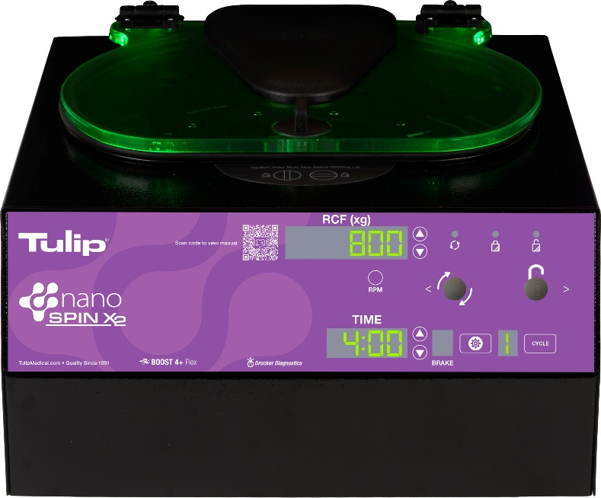
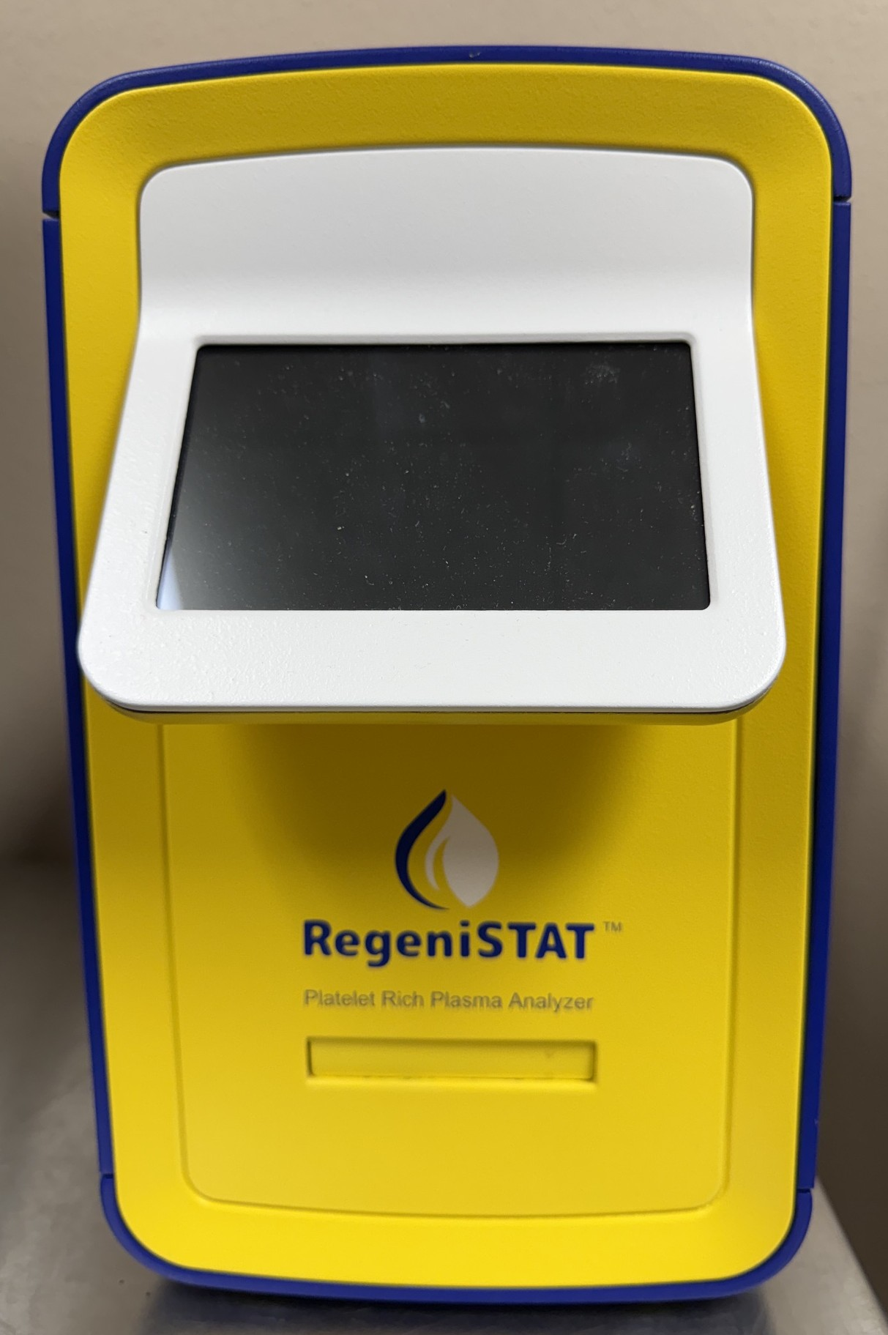
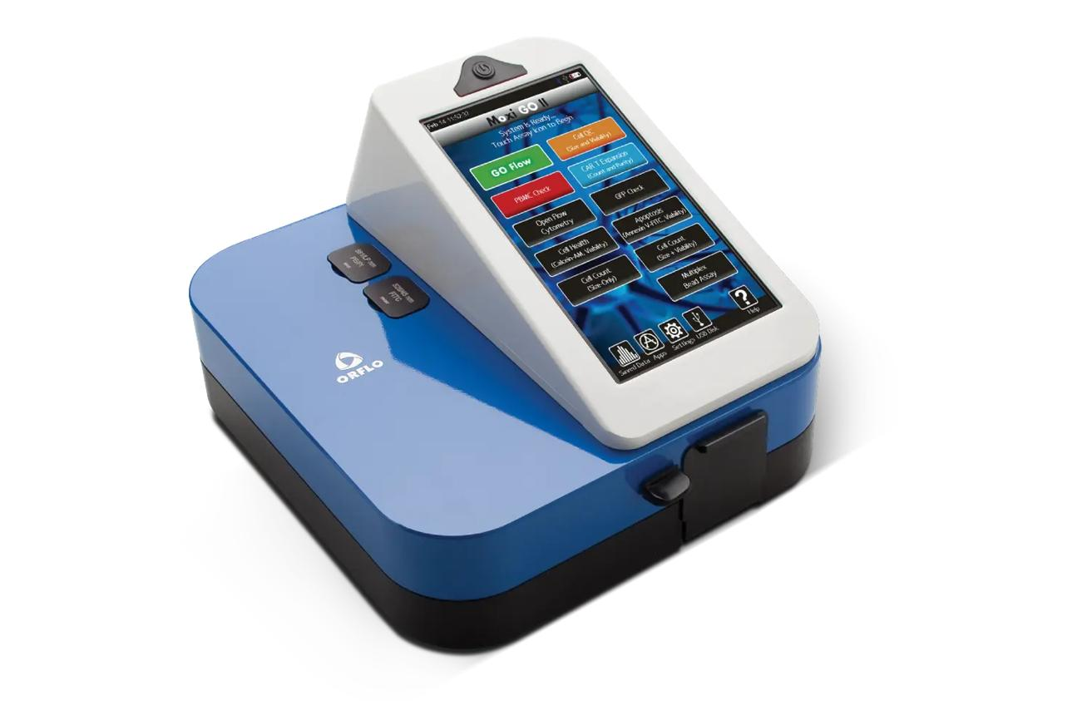
EQUIPMENT NEEDED: SMALL CLINIC EXAMPLES
Novel Centrifuge:
Cellular Values
+
NANOSPIN X2 Heated Chamber Cell Counter/Flow Cytometer
Same centrifuge. Same protocol. Same day. — Heated Chamber – US Made Need a Simple Hemocytometer -- Difference in Platelet DOSE delivered
Without baseline measurements, this variability is NOT Visible
15

Slide 16
Minimum Needed Documentation: Standardize
DATA ELEMENT | WHEN RECORDED | METHODS | INSTRUMENT / DETAIL
Platelet Baseline CBC | Is Before Procedure, Done For Baseline Content | Hemocytometry | Whole blood count; Hemocytometer
cSVF Viability % | Done Post-Processing, Measure After Injection | Cell Counting; Flow Cytometry; Trypan Blue | Simple Auto Cell Counter; FL Counters; Flow Cytometer
Total Nucleated Cell Counts | Post-Processing, After-Injection Determined | May Be Measured As Above (Optional) | ** Count per mL
Average Cell Diameter | Post-Processing (Average Optional) | Calibrated Reticle or Automated Counters | µm Distribution Ave; Cell Membrane Lysis (Option)
HD-PRP Concentration Ratio Determination | Second-Spin Determine Concentrate Measured | Post-Spin ÷ Baseline = (X Base); Actual Numbers | Patient-Specific Ratio & Counts Documented
Outcome Measure (Pre & Post Therapy) | Day 0; Weeks 8, 12, 24, 52 (Clinical Option) | Standardized Tools & Testing | VAS, KOOS, DASH, etc. Many Options; U/S
Regenerative Medicine | Point-of-Care Standardization
16

Slide 17
VI. IMPLICATIONS FOR THE ENTIRE FIELD
Small clinics NOT being asked to become research centers- Simply Measure What Is Deployed
1
2
3
Evidence Generation AT SCALE
Interaction Analysis
Clinical Reproducibility
Aggregated -linked outcome records across many Providers treating thousands of patients — a complementary evidence base evolves rapidly
When both tSVF + HD-PRP doses are identified: synergistic, additive, or independent effects can be assessed for first time
Understand why patients improve, why some improve more, and how to reproduce success across encounters
Three Enabling Requirements:
1) Shared vocabulary 2) Commitment to minimum documentation standards 3) Recognition that dose–response is a clinical question — not some future research question !!
Regenerative Medicine | Point-of-Care Standardization
17

Slide 18
SUMMARY PRINCIPLE
Characterizing cSVF IS NOT a Burden
Reserved For Clinical Trials
It is a core obligation
Every practitioner who wishes to understand:
?? Why their patients improve,
?? Why some improve more than others,
?? How to reproduce healing success.
Equipment Processing Preparation can Gather Data That Initiates the EVIDENCE!
18

Slide 19
MEASURE
DOCUMENT
AGGREGATE
Doses
Outcomes
Evidence
*Hemocytometry Twice before procedure (PRP)
*Content, Viability, Total Count, Cell Size Profile for tSVF
*Baseline + Achieved
-Concentration HD-PRP.
*Standard Shared vocabulary-Protocols
*Need Minimum Documentation For Standards in ALL cases
*Every encounter is a unit of evidence production.
*Standardized DATA Records
*Instruments used baseline and defined follow-up intervals
*Link outcome records to dose data.
Content-Response Ability | Robert W. Alexander, MD, FICS
19

Slide 20
SAMPLE DOCUMENTATION FORM:
Patient ID
Platelet Kit
Area Harvested, Cannula, Openings
cSVF Total Content Count
Live/Dead Count
Date Procedure
Platelet Baseline
Total Comp Graft (cc)
Viability %
Follow Up Exam Date.
Treatment Areas
Platelet Concentrate Total
Volume Test (cSVF in cc)
Average Cell Diameter Microns - Size)
Clinical Note: (Drag/Drop)
Add Notes (3 Available)
20

Slide 21
ACADEMY REGENERATIVE THERAPIES & SCIENCE
ARTS SUMMIT 2026 * THANK YOU !!
Robert W. Alexander, MD, FICS
Contact Information:
Email: rgvclinic@gmail.com
Phone: 406-375-5451 or 406-777-4477
FAX: 866-766-5458
For Every practitioner who wishes to understand:
INITIATE the EVIDENCE!
21

